Slide 1
DNA Secuencing Classifier using Machine learning
Team Members:
Mohamed Medhat Mohamed Ali
Mohamed Fathi Said
Alaa Ahmed DR\Sara Salah
Ata Ahmed Ata
Mahmoud Abdelghany Mostafa
Mahmoud Medhat Mohamed
Galal Mostafa

Slide 2
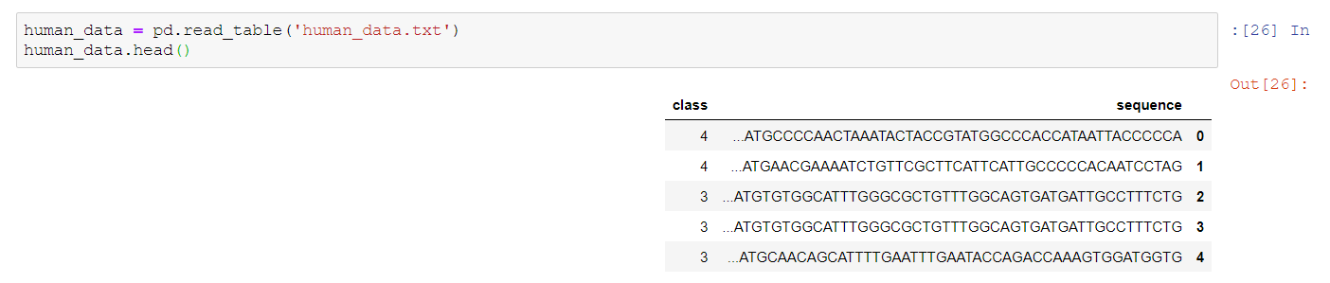
Import numpy ,pandas and matplotlib libraries for reading data ,visualization and other functions. We have some data for human DNA sequence coding regions and a class label (kaggle.com)

Slide 3
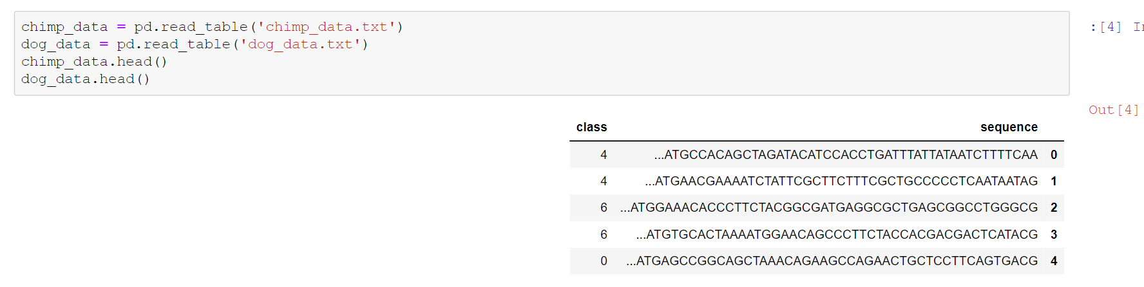
Load Chimpanzee DNA data and dog

Slide 4
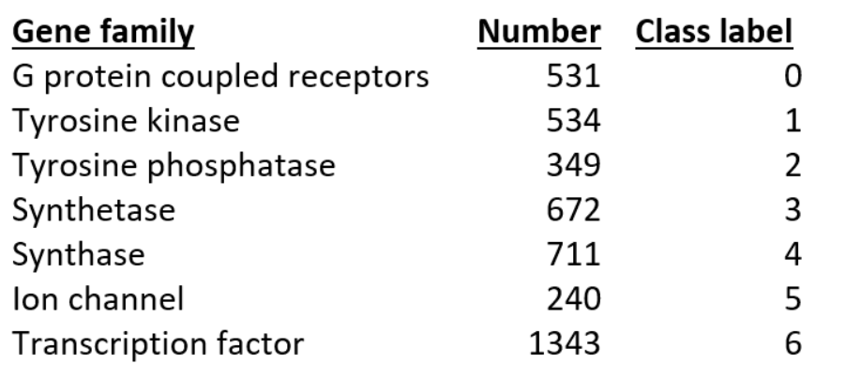
Here are the definitions for each of the 7 classes and how many there are in the human training data. They are gene sequence function groups.

Slide 5
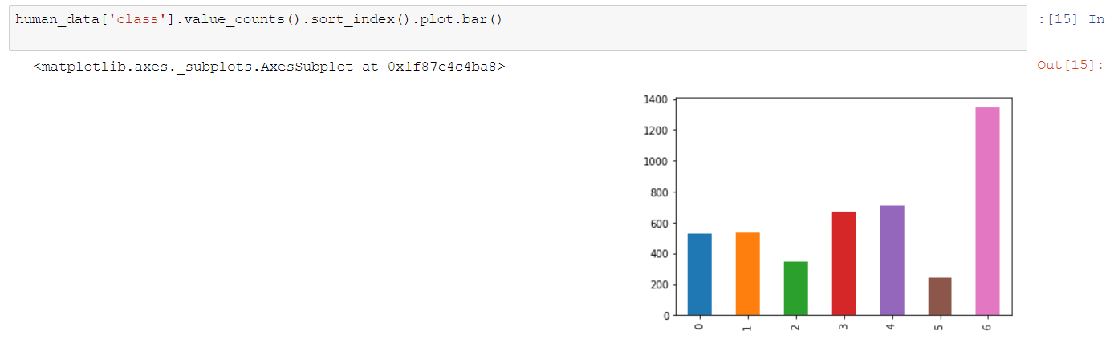
If we have a look at class balance we can see we have relatively balanced dataset.

Slide 6
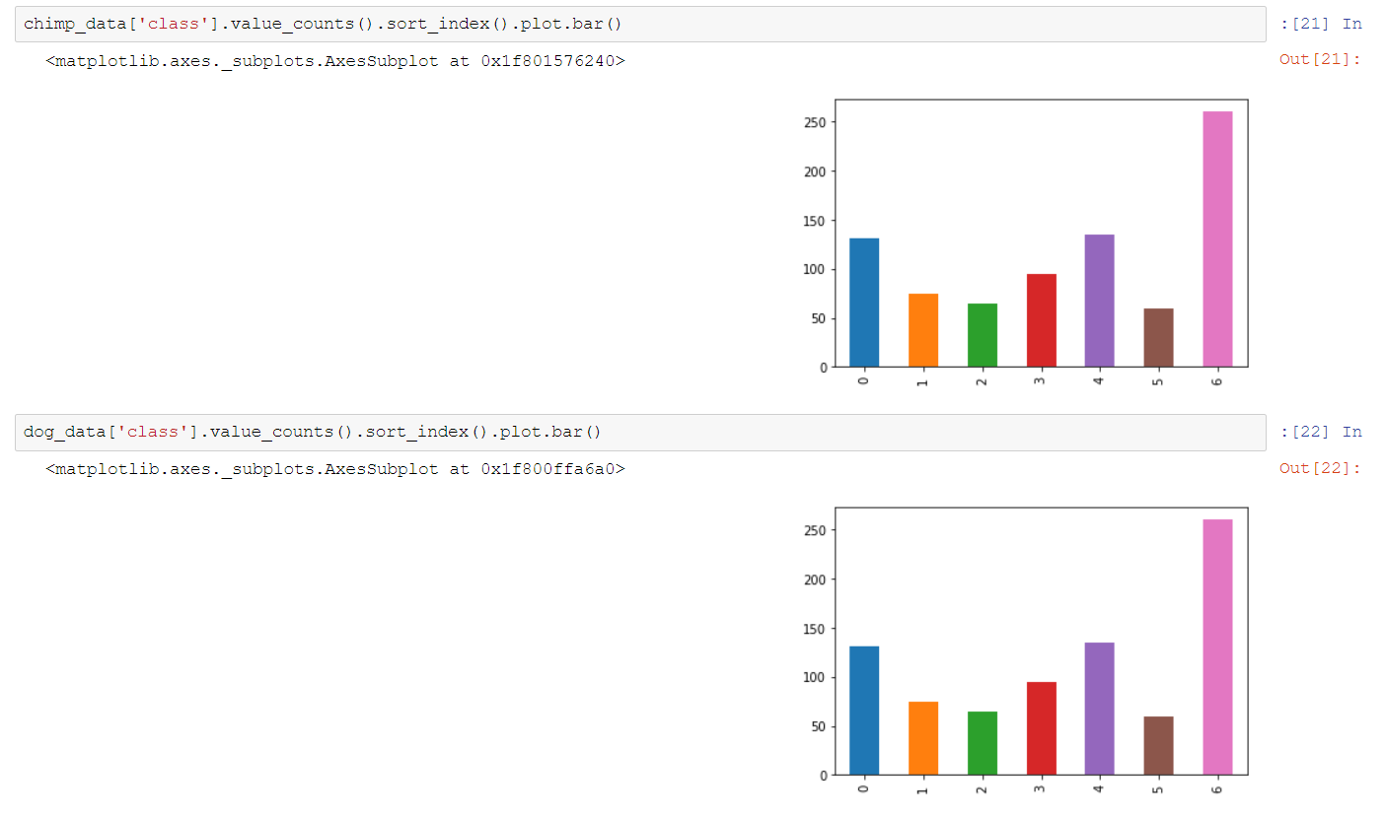
For Champ and dog

Slide 7
k-mer counting
The method we use here is simple and easy. we first take the long biological sequence and break it down into k-mer length overlapping “words”. For example, if I use "words" of length 6 (hexamers), “ATGCATGCA” becomes: ‘ATGCAT’, ‘TGCATG’, ‘GCATGC’, ‘CATGCA’. Hence our example sequence is broken down into 4 hexamer words.

Slide 8
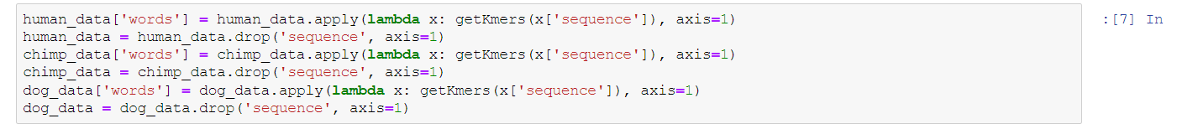
Define a function to collect all possible overlapping k-mers of a specified length from any sequence string.
Then convert our training data sequences into short overlapping k-mers of legth 6.

Slide 9
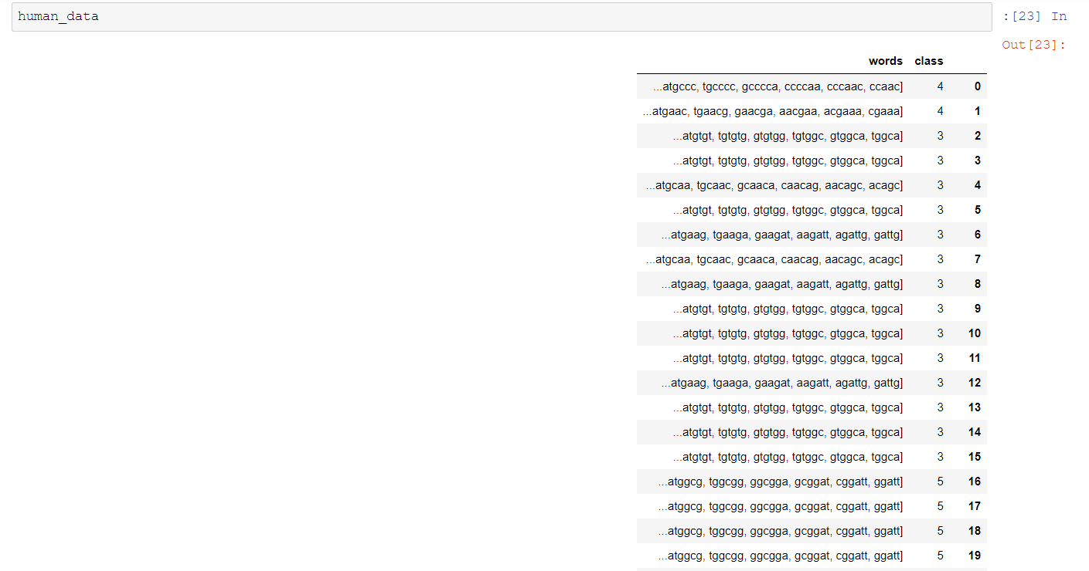
Now, our coding sequence data is changed to lowercase, split up into all possible k-mer words of length 6 and ready for the next step.

Slide 10
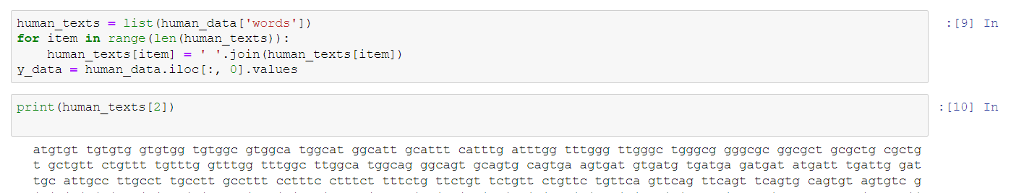
we need to convert the lists of k-mers for each gene into string sentences of words that the count vectorizer can use.

Slide 11
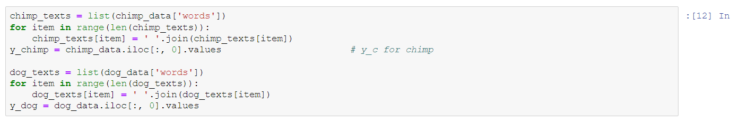
We can also make a y variable to hold the class labels.
We will perform the same steps for chimpanzee and dog.

Slide 12
NLP Concepts
Natural language processing: Aims to build machines that understand and respond to text or voice data—and respond with text or speech of their own—in much the same way humans do.
Scikit-learn: is an open source data analysis library, and the gold standard for Machine Learning (ML) in the Python ecosystem.
CountVectorizer (): Convert a collection of text documents to a matrix of token counts.

Slide 13
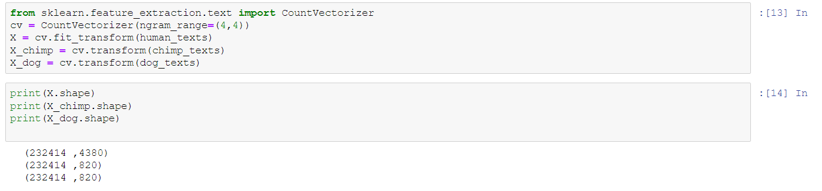
Now we will apply the BAG of WORDS using CountVectorizer using NLP
* Creating the Bag of Words model using CountVectorizer(). * This is equivalent to k-mer counting. * The n-gram size of 4 was previously determined by testing.

Slide 14
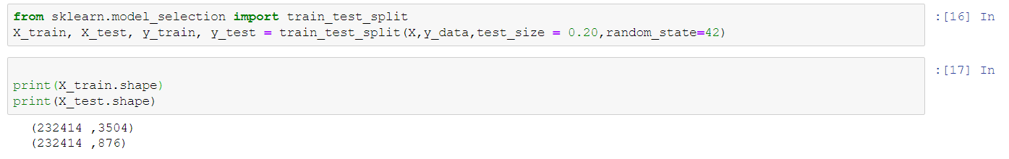
Splitting the human dataset into the training set (80%)and test set(20%)

Slide 15
classification models: used to assess how well machine learning classification models perform in a given context
These performance metrics include accuracy, precision, recall, and F1-score. Because it helps us understand the strengths and limitations of these models when making predictions in new situations, model performance is essential for machine learning.

Slide 16
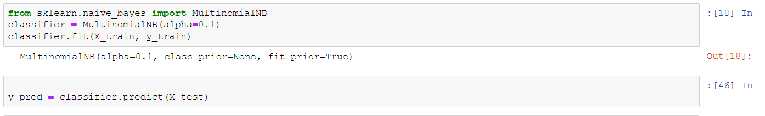
A multinomial naive Bayes classifier will be created. I previously did some parameter tuning and found the ngram size of 4 (reflected in the Countvectorizer() instance) and a model alpha of 0.1 did the best.
* Multinomial Naive Bayes Classifier: is suitable for classification with discrete features
* The alpha parameter was determined by grid search previously.

Slide 17
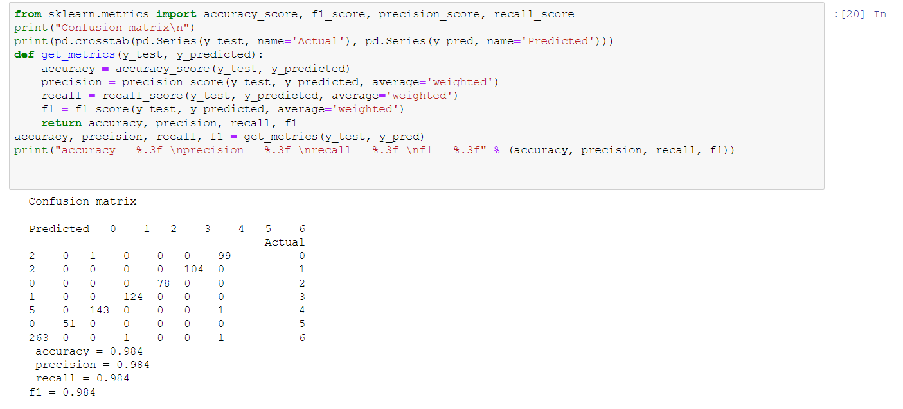
Model performce metrics like the confusion matrix, accuracy, precision, recall and f1 score. We are getting really good results on our data

